Slide 1


K.RAMAKRISHNAN COLLEGE OF TECHNOLOGY (AUTONOMOUS), TRICHY
Comparing Annual Rainfall Across States
Using Boxplots
PRESENTED BY
MOHAMMED RAASITH H -2303811724321069

Slide 2
PRESENTATION OVERVIEW
Problem Identification
Objective
Proposed system
Block diagram of proposed system
R concept used
Modules Description and Implementation
Source code
output

Slide 3
PROBLEM IDENTIFICATION
The project uses R code to create boxplots that compare annual rainfall across four South Indian states. This helps quickly identify trends, differences, and outliers in the rainfall distribution.
With the help of Plotly, the code adds features like zoom and hover for better user interaction. This allows deeper exploration of rainfall data in a more dynamic and engaging way.
Three different R methods—base R, lattice, and Plotly—are used to display the same dataset. This shows how varied visualization tools can provide multiple perspectives on the same data.

Slide 4
OBJECTIVE
The objective of this project is to visualize and compare the annual rainfall data across four South Indian states using boxplots to identify patterns, variations, and outliers. It also allows for interactive exploration with Plotly, enabling features like zooming and hovering.
The project demonstrates three R visualization methods—base R, lattice, and Plotly—to present the data in different formats.
This helps users gain a better understanding of the data. The approach offers flexibility in how the data is visualized and interpreted.

Slide 5
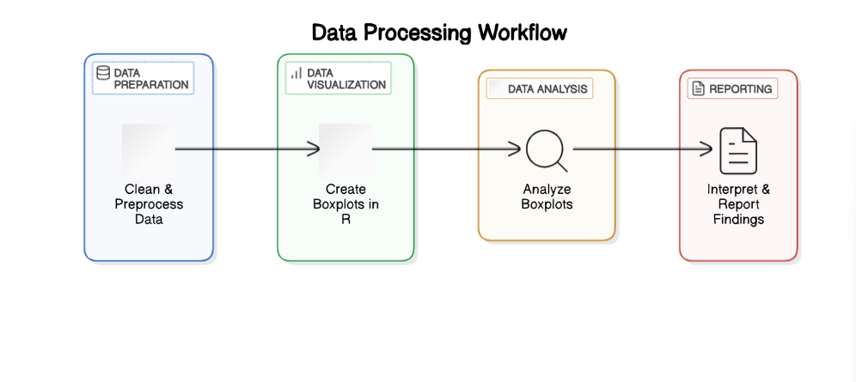
PROPOSED SYSTEM
BLOCK DIAGRAM

Slide 6
R CONCEPT USED
data.frame() – Used to create a structured dataset where columns can store different types of related data like state names and rainfall.
rnorm() – Generates a set of random numbers following a normal distribution, which is ideal for simulating realistic rainfall variations.
boxplot() – Produces a box-and-whisker chart to visually compare the distribution, spread, and outliers of rainfall across different states.
plot_ly() – Builds interactive visualizations that allow users to explore data through hovering, zooming, and clicking on plot elements.
par.settings – Provides advanced styling options in lattice plots to customize box color, symbol appearance, and plot elements for better visual appeal.

Slide 7
ADVANTAGES OF PROPOSED SYSTEM
The system provides a clear visual comparison of annual rainfall across four South Indian states using boxplots.
The use of Plotly allows users to explore the data interactively with zoom and hover features for better insights.
It demonstrates multiple R plotting methods—base R, lattice, and Plotly—making the analysis adaptable and educational.

Slide 8
MODULES DESCRIPTION
Data Preparation:
Base R Boxplot:
Lattice Boxplot:
Plotly Interactive Boxplot:

Slide 9
MODULES IMPLEMENTATION
Data Preparation:
A data frame rainfall_data is created with 40 entries, 10 for each state (Tamil Nadu, Kerala, Karnataka, Andhra Pradesh).
Rainfall values are generated using rnorm() to simulate natural variation with a normal distribution.
Each state has different average rainfall and variability to reflect real climate differences.
The data frame includes State (region) and AnnualRainfall (rainfall in millimeters) columns for analysis.

Slide 10
MODULES IMPLEMENTATION
Base R Boxplot:
Create Simulated Rainfall Data: Generate normally distributed rainfall values for each state with distinct averages and variability:
Clean the Data: Remove any missing or negative values and ensure correct data types:
Plot Using Base R Boxplot: Visualize annual rainfall distribution by state:
Interpret the Boxplot: Compare rainfall variability and median levels across states:

Slide 11
MODULES IMPLEMENTATION
Lattice Boxplot:
Data GenerationGenerated synthetic rainfall data using rnorm() for 4 states, with 10 entries each to simulate regional variation.
Data CleaningRemoved missing and negative values, and converted State into a factor for proper categorical handlingData StructuringStructured the data frame with State (factor) and AnnualRainfall (numeric) columns for visualization.
Lattice VisualizationUsed bwplot() from the lattice package to create boxplots comparing rainfall distributions across states.

Slide 12
MODULES IMPLEMENTATION
Plotly Interactive Boxplot:
Data GenerationCreated synthetic rainfall data using rnorm() for 4 states, with 10 observations each to mimic realistic patterns.
Data CleaningRemoved missing and negative values, and ensured State is a factor for accurate group-wise plotting.
Data StructuringOrganized the data frame with State (factor) and AnnualRainfall (numeric) for interactive visualization.
Interactive VisualizationUsed plot_ly() to build interactive boxplots, allowing tooltips, zoom, and hover for deeper data insight.

Slide 13
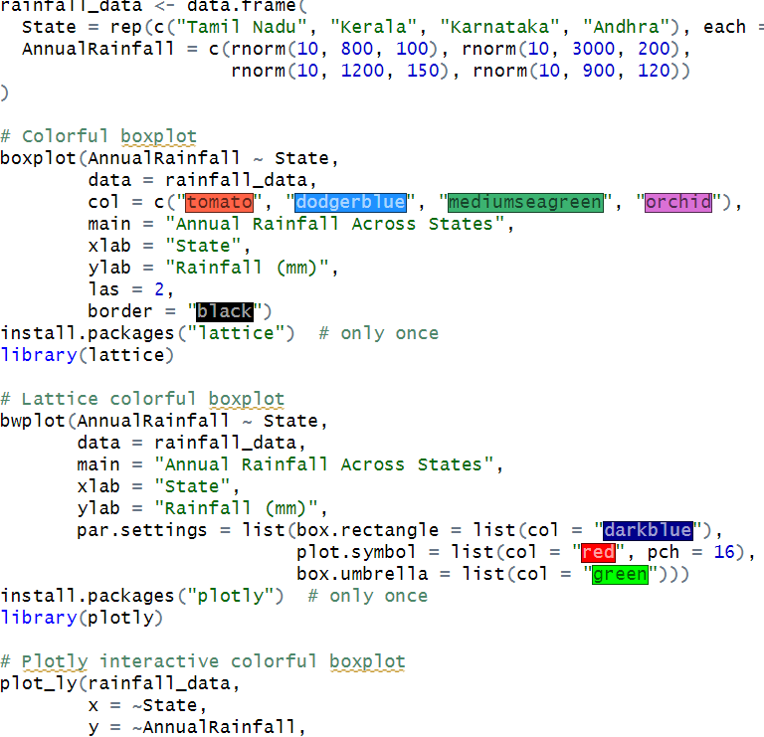
SOURCE CODE

Slide 14
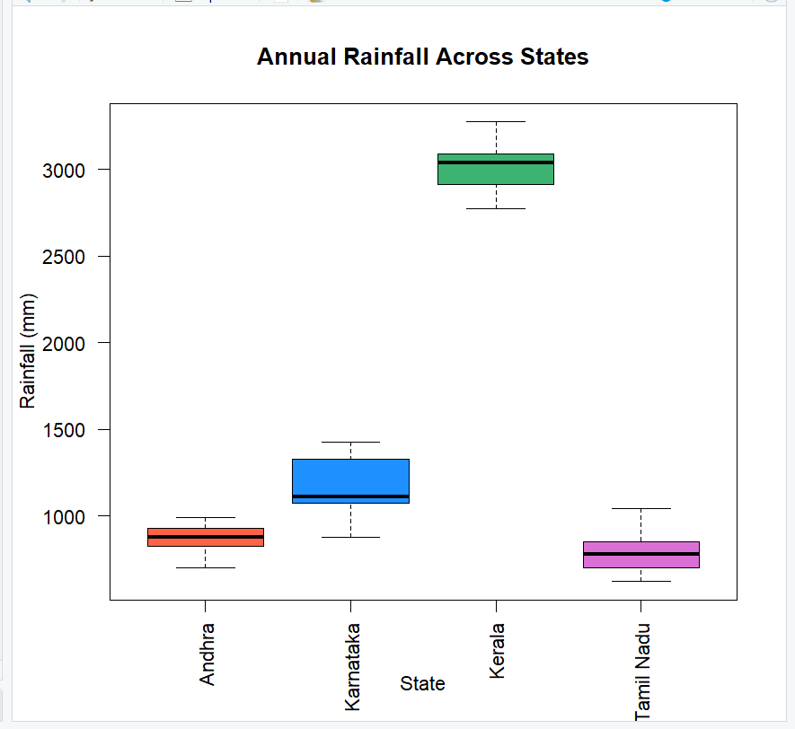
output

Slide 15


